Slide 1
Kriging ReadMe

Slide 2
First, run the calibration code to get calibrated field data
We will use the .txt outputs generated from selecting “save to database” in the settingsSet
Columns we will use: estimate, latitude, longitude, elevation
Latitude & longitude must be populated in DeploymentLog.csv to appear in the final text file
Formatting in the Deployment Log:
Latitude & longitude must be in decimal format (not minutes & seconds)
Include negative signs where applicable
Do not include letters (N or W)
As long as points are in the same hemisphere it will work fine
Code is expecting a decimal number, not a string including numbers & letters

Slide 3
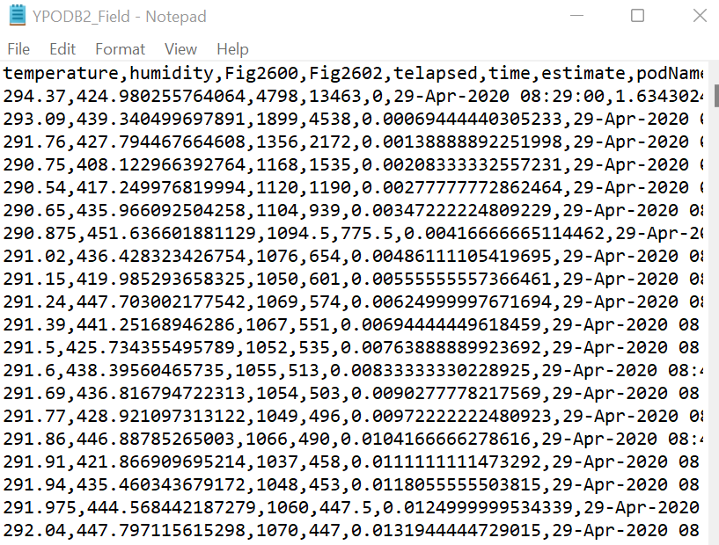
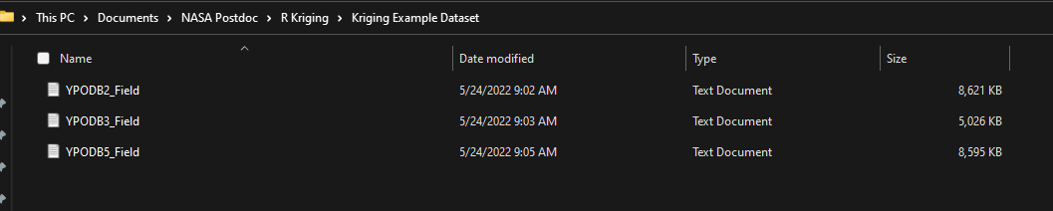
Reformatting the data
Move each of the “database” text files you want to use into a folder

Slide 4

Download necessary packages
To access command line, click windows button on computer, then type CMD
To install pykrige, type in the command line:
pip install pykrige
Then press enter
Some other necessary packages may also need to be installed in the command prompt
google any errors that come up for instructions as needed

Slide 5
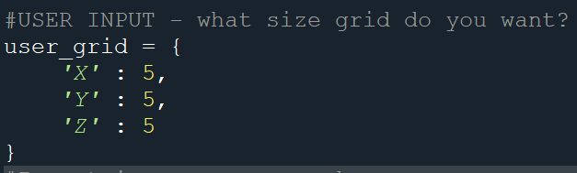
User inputs
User decides what size grid to use (ex. 5x5x5)
This is relative based on how spaced apart your points are
I.e. one grid box does not equal a specific measurement – will change when different points are used
This will be something to mess around with while we fine tune our analysis

